Slide 1
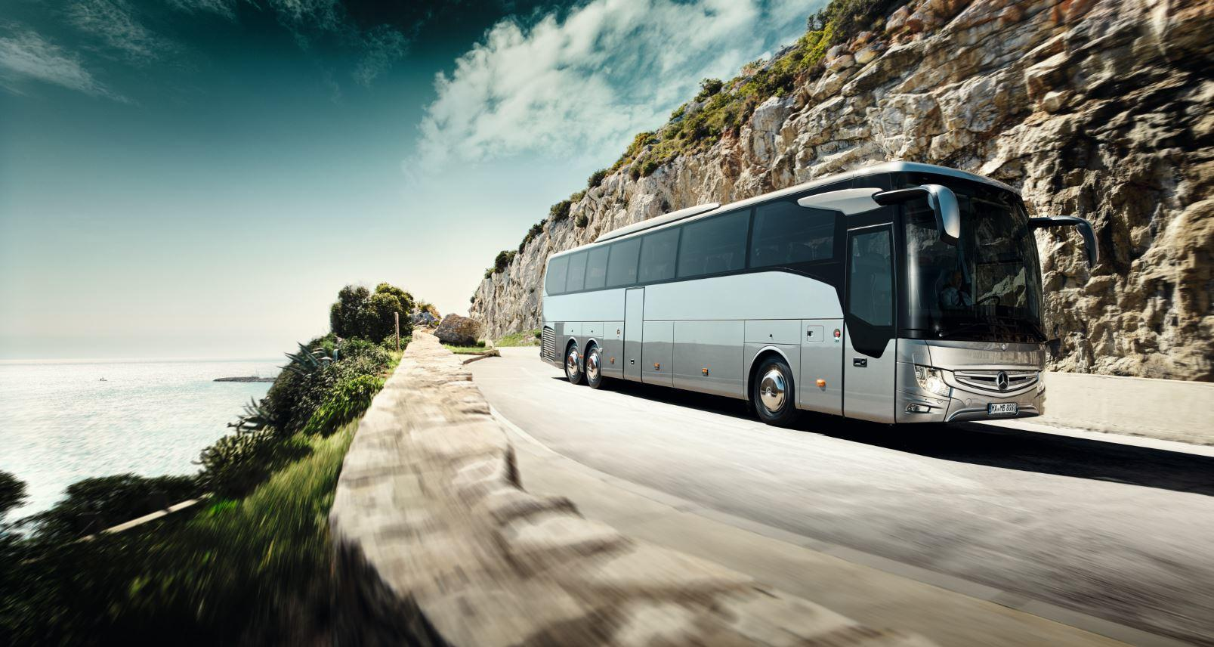


Easy Journey
Bus Ticketing System
A System
That Makes Your Journey
Easier
BY
Kingston Polytechnic College
CST Departmental
Students of final year Group B

Slide 2

Table of Contents
Abstract
Introduction
Requirement Analysis
Design
Conclusion
Bibliography

Slide 3

Abstract
Easy Journey Bus ticketing management system is related to the manages timing, fare details and booking ticket for journey.
This system is useful in for to manage the system of buses in local and rural areas.
This system is also removes the human mistake like missing buses and also help people to find, which bus will reach to his or her destination and they will be informed about fare and departure time of bus.
We implemented some modules in our project, like registration and login module for both admin and customer, Bus management module, payment module etc.
It provides functions i.e. Search available buses from nearest bus stop to destination, Bus ticket booking in advance, Bus maintenance, Record maintenance and remainder (information stores).

Slide 4
Introduction
Easy Journey is an Online Ticketing System that works within localhost network. The software program “Easy Journey ” provides
bus transportation system, a facility to reserved seats,
cancellation of seats and different types of enquiry which need
an instant and quick reservation. Easy Journey is built for manage
and computerize the traditional database, ticket booking and
tracking bus and journey made easy. It maintains all data’s of
users , bus details, reservation details, booking details,
customer details.

Slide 5
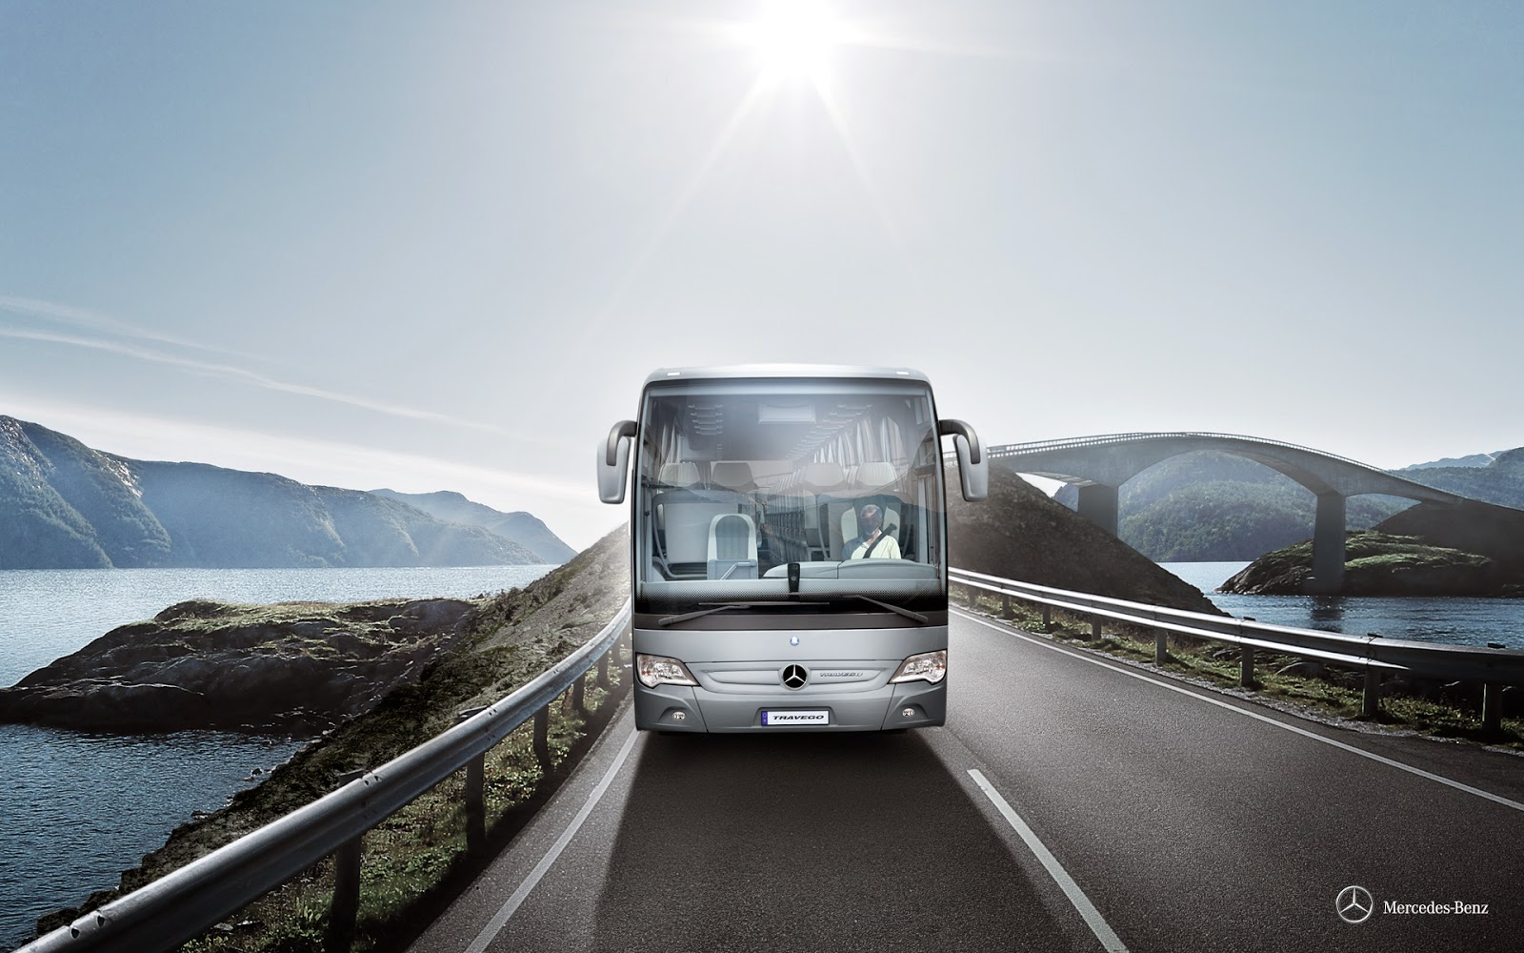
Analysis
Requirement analysis is a software engineering task that bridges the gap between the system level software allocation and software design.
It enables the system engineer to specify software function and performance, indicate software interface with other system elements, and establish design constraints that the software must meet.
It provides the software designer with a representation of information and function that can be translated to data, architectural and procedural design.

Slide 6
Problem statement
In resent days, The system that are using by the captain of a bus currently is an internal system and just used to sell bus ticket in the bus or at the counter. Customer or passenger has to go to the bus or counter to buy ticket or ask for bus schedule. Furthermore, customers need to pay cash when they buy tickets and sometimes needs to queue up long time to get the bus ticket.

Slide 7
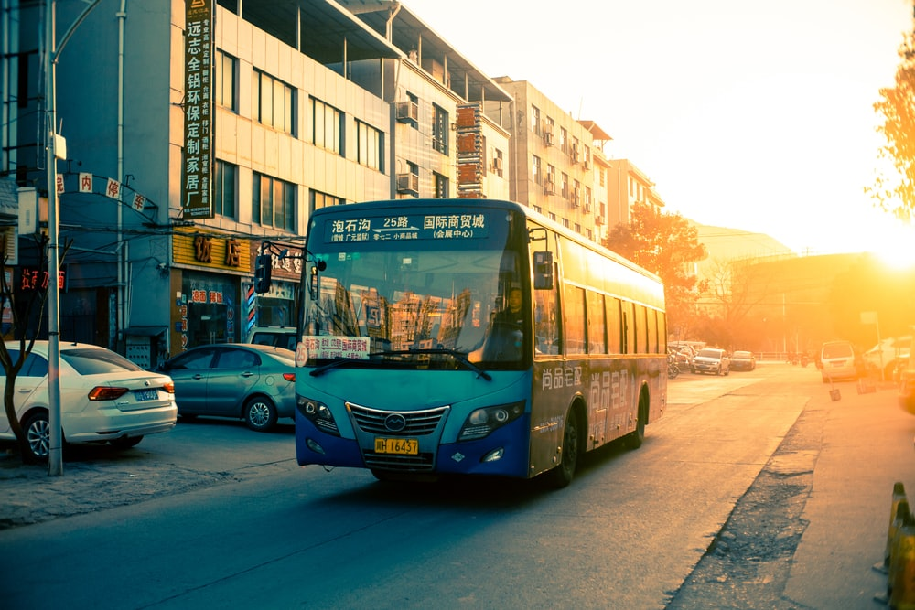
Solution
The method to solve this problem is to create an online bus ticket Booking system . Customer can reserve or buy the Bus seat ticket over the Internet, 24 hours a day, 7 days a week and the bus ticket can't be lost, stolen or left behind. In addition, the online system lets the customers check the availability of the bus ticket before they buy bus ticket. Furthermore, customers no need to pay cash to buy bus ticket because they can pay the bus ticket on the traveling time.

Slide 8
System Specification
Hardware Configuration:
Computer Processor : i3(Generation N/A)
RAM : 4GB(LPddr4,1600Mhz,Min)
Graphics : Integrated
Storage : 15mb (Recommended)
Software Specification:
Operating System : Windows 7 or Above
Web Browser : Chrome, Edge, Firefox
Language Used : HTML, CSS Bootstrap, PHP(7.0), JavaScript
Database : MySQL(5.1)
Web Server : XAMPP(Apache, MySQL),
Light HTTP, IIS

Slide 9
Er-Diagram

Slide 10
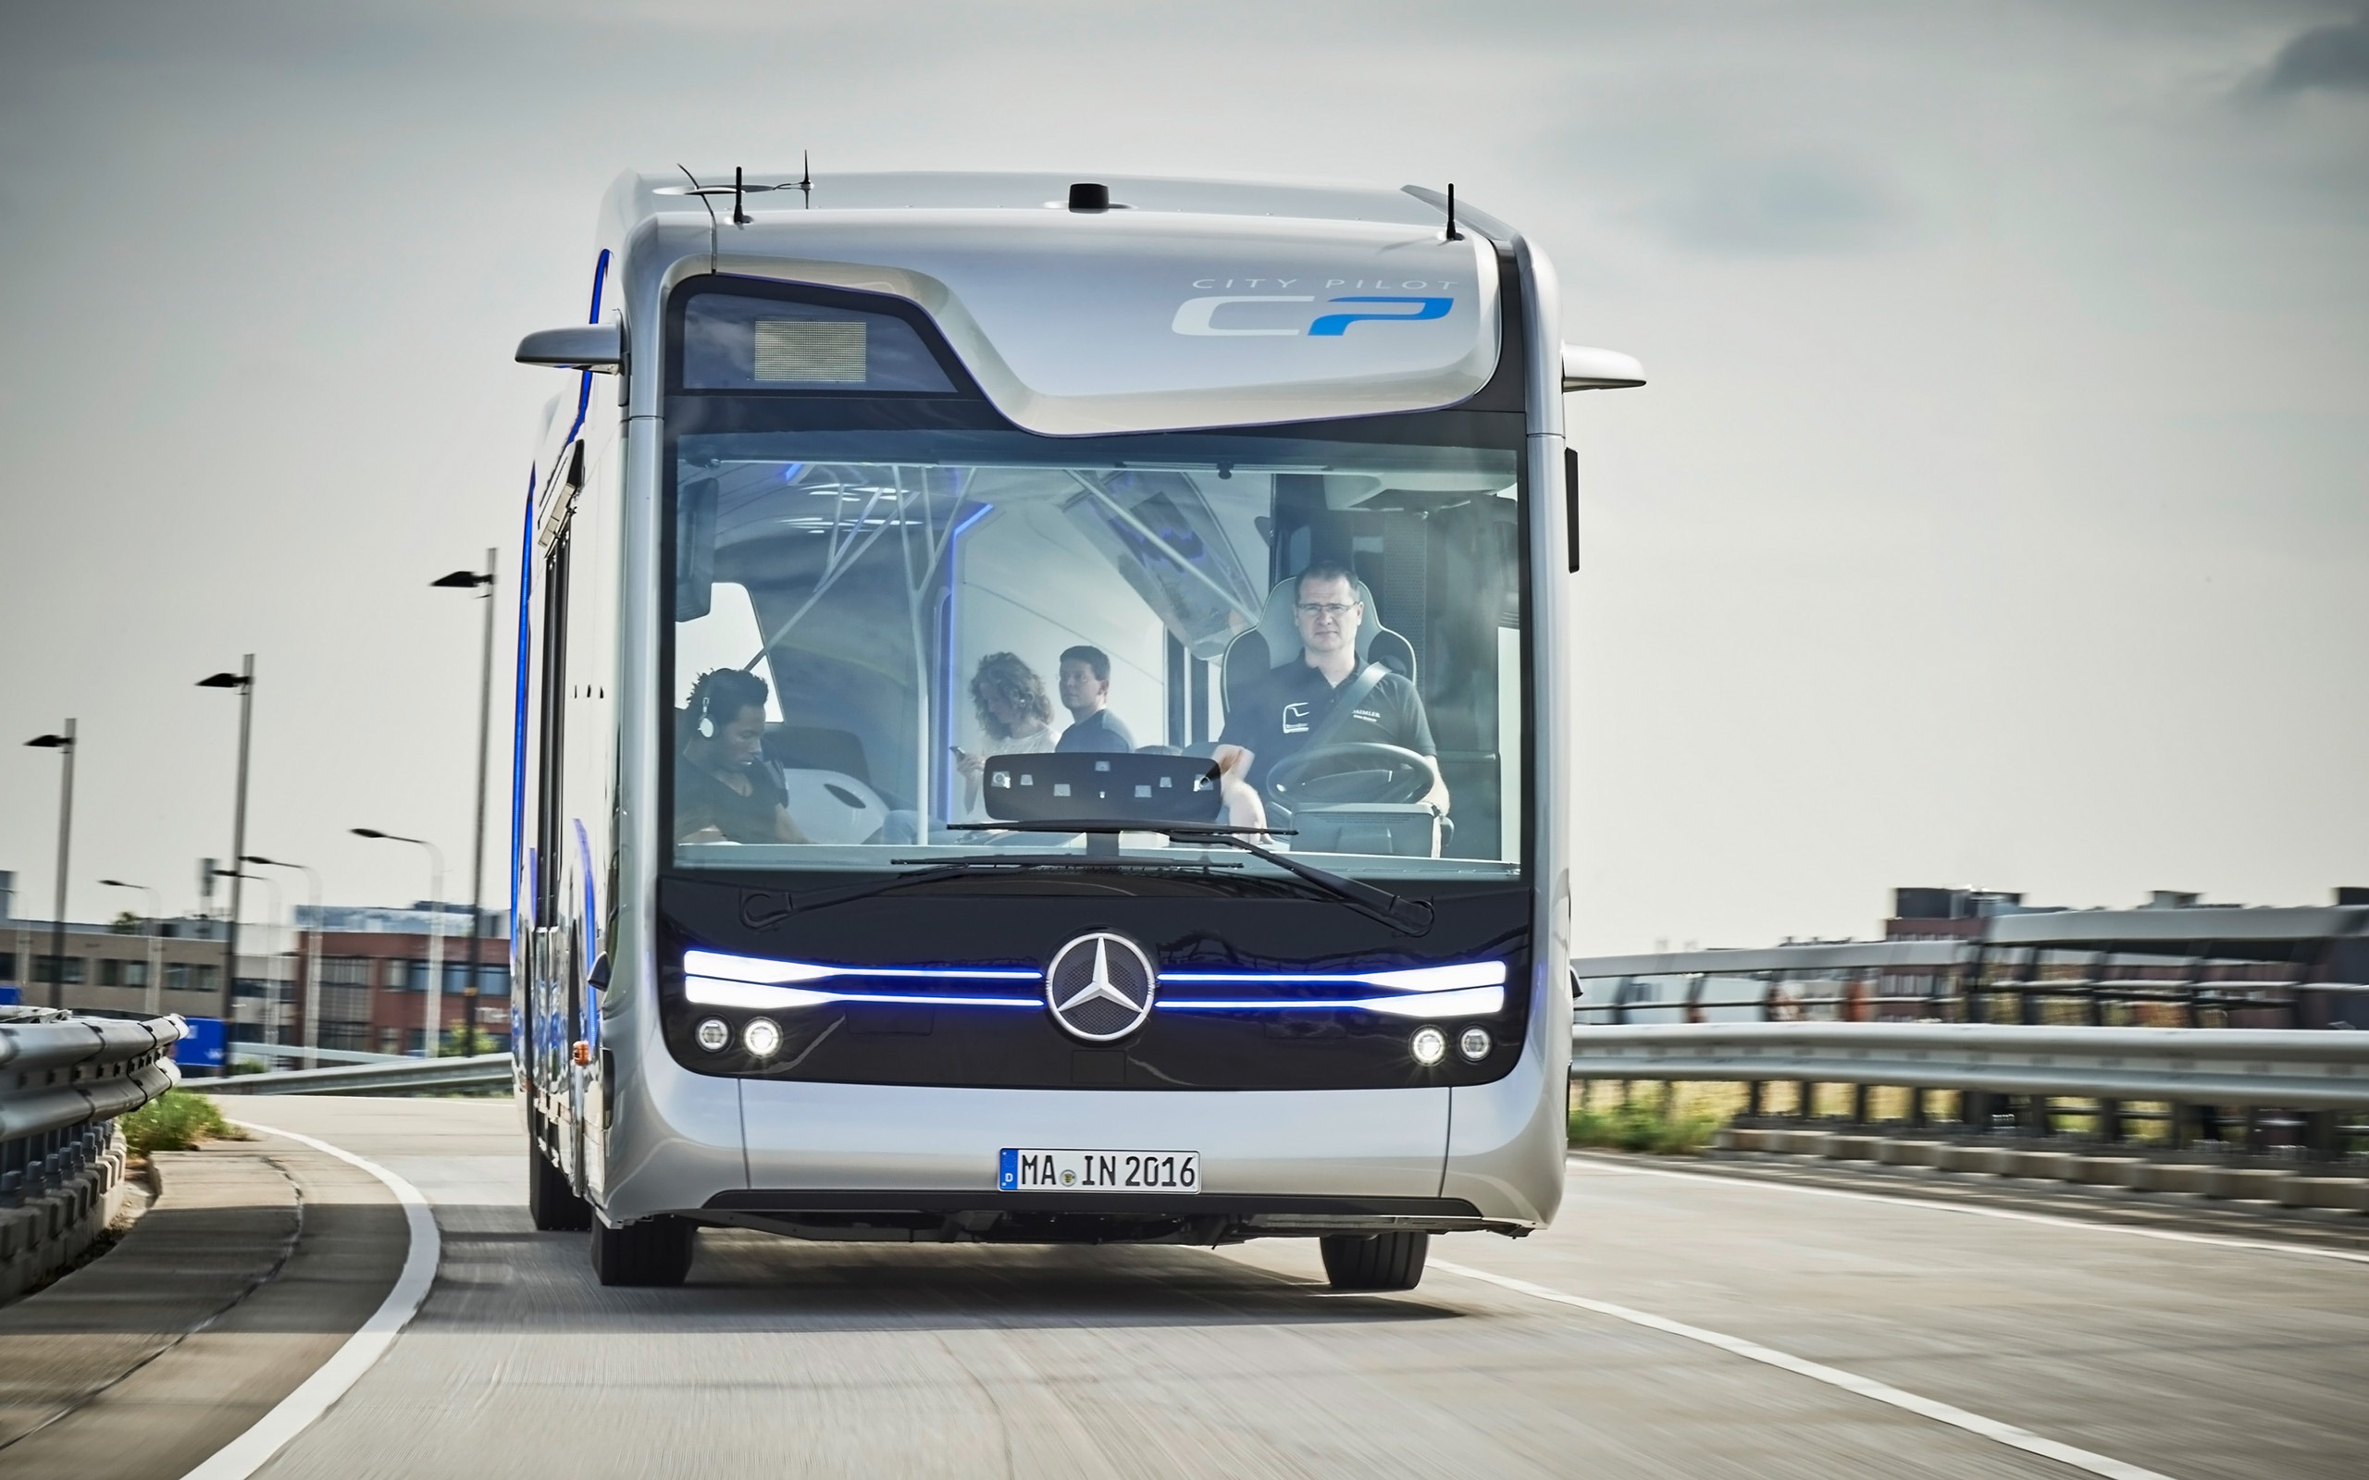
Design
Using SRS as input, system design is done. System design included designing of Website and hardware i.e. functionality of hardware and software is separated-out. After separation design of Database modules is done. The design process translates requirements into representation of the Website that can be assessed for quality before generation of code begins

Slide 11
Modules Implemented :
Login or Registration Module
Search Module
Bus info Module
Payment Module

Slide 12
Data Flow Diagram
A data-flow diagram is a way of representing a flow of data through a process or a system. The DFD also provides information about the outputs and inputs of each entity and the process itself.
DFD does not have control flow and no loops or decision rules are present. Specific operations depending on the type of data can be explained by a flowchart. Data Flow Diagram can be represented in several ways. The DFD belongs to structured-analysis modeling tools.

Slide 13

DFD “Level 0”
Customer Management
User Dashboard Management
Payment Management
Easy
Journey
Booking Management
System User Management
Login Management

Slide 14
DFD “Level 1”
User Dashboard Management
Generate Riding Report
Confirm Booking Management
Generate Confirmation Report
Easy
Journey
Login Management
Check User Login Details
System User Management
Generate System User Report

Slide 15
DFD “Level 2”
Admin
Login To SYSTEM
Check Roles of Access
Manage BUS Details
Manage User Dashboard
Forgot Password
Check Conditions
Manage Modules
Manage Customer Details
Manage Booking Details
Send Email To User
Manage Payment Details
Manage Report
Manage System Admins
Manage Roles of User
Manage User Permission

Slide 16

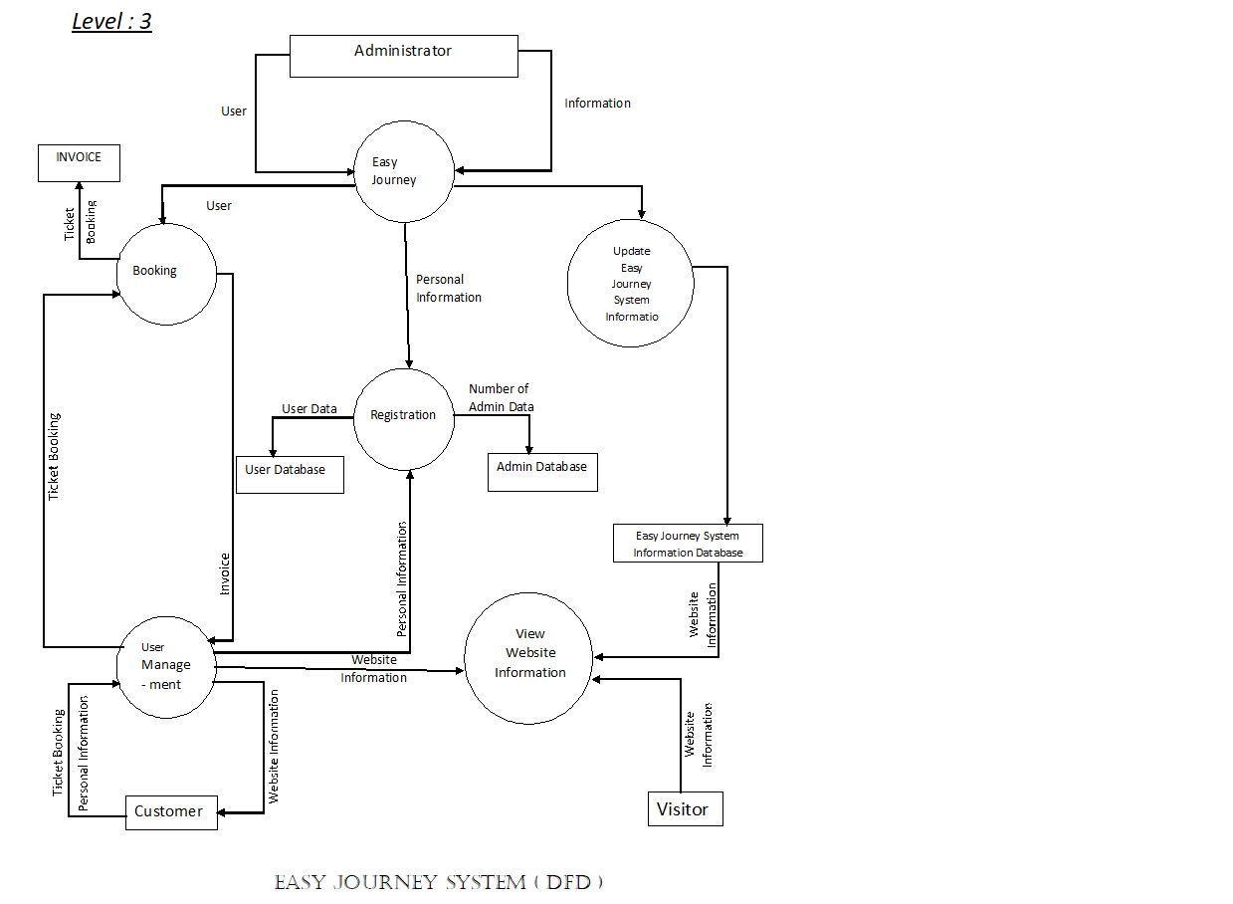
DFD “Level 3”

Slide 17

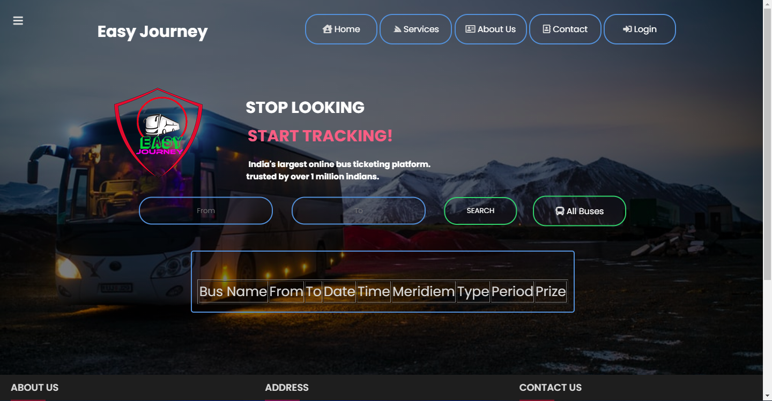
Home Page:

Slide 18
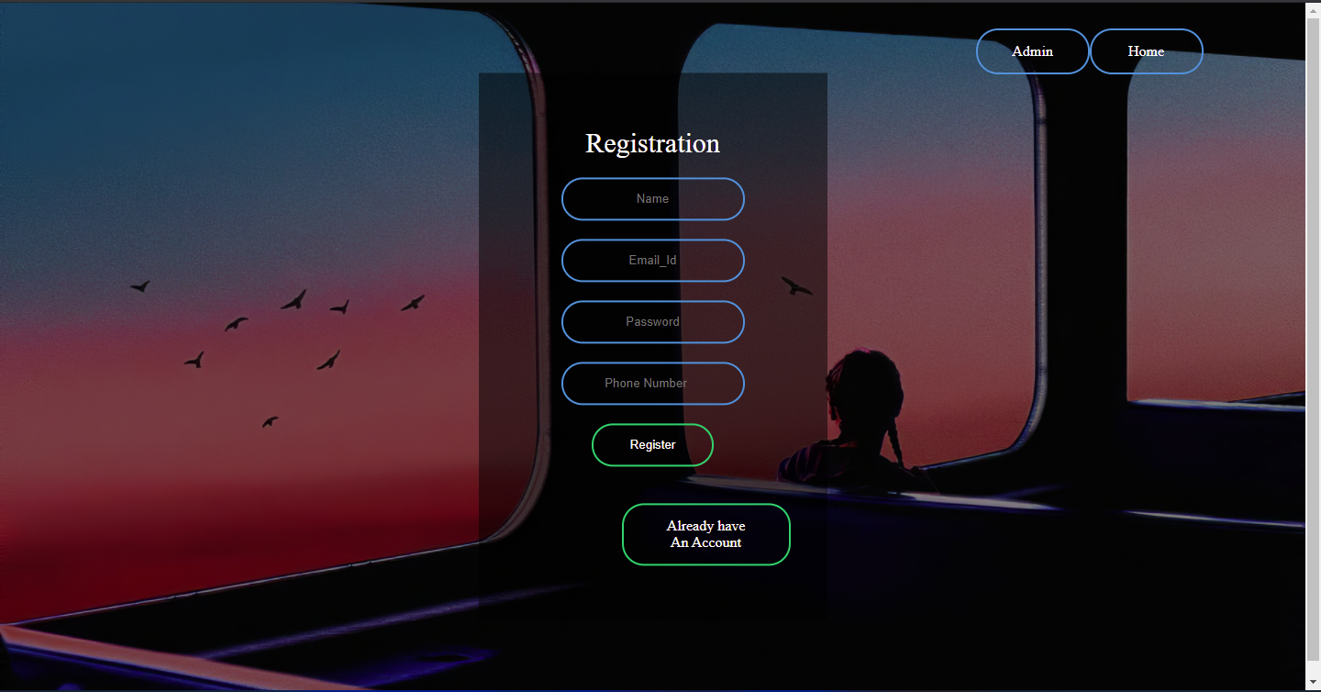
User Registration:

Slide 19
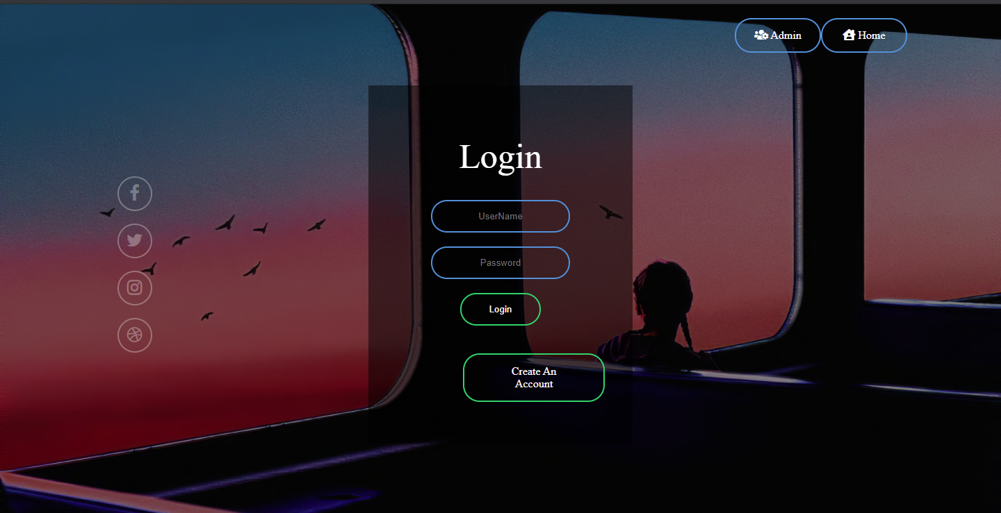
User Login:

Slide 20
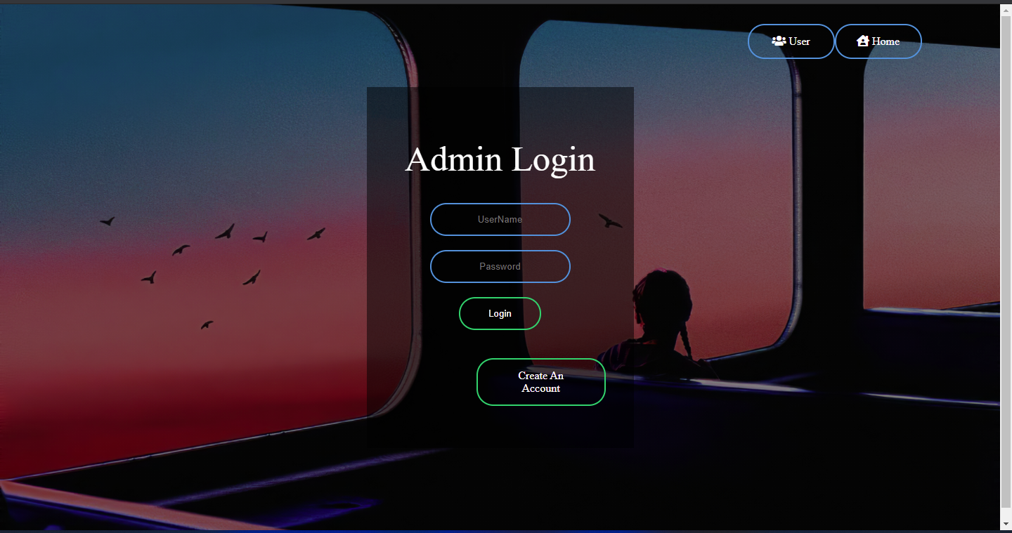
Admin Login:

Slide 21

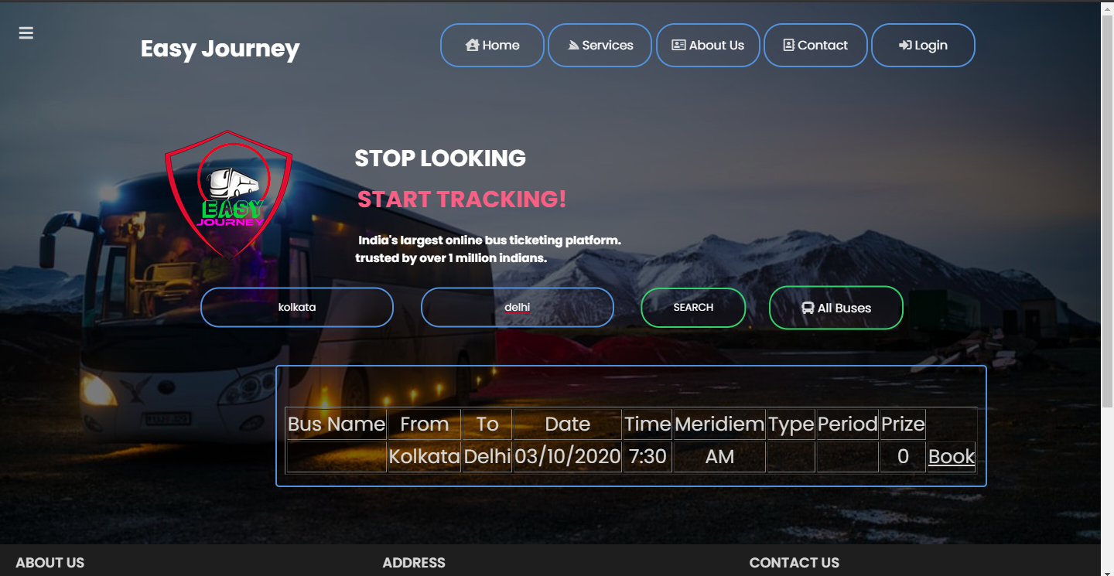
Search Result :

Slide 22
Future Works :
As mentioned above , although our system had been completed but it is not perfect, we had planned to make some enhancement in the future.
We think that our system still has potential to grow. Besides, we will include more functions and introduce more widgets to the system. Like
1. Mobile app
2. Mobile version
3. Time reminder.
In future we will add new routes and buses ,spots according to need of passengers
We will add unique identification system to identify our system.
We also Plane to enhance the UI so that it looks more attractive and interactive.

Slide 23

Conclusion :
Easy Journey is an online bus ticketing system which provides online reservation of bus.
This system is user friendly and accurate.
This system is available 24hours and efficient in reservation.
It has no hidden costs in fares.

Slide 24
Bibliography :
Websites :
https://scholar.google.com/
https://www.redbus.in/
https://wbtc.co.in/
https://www.wikipedia.org/
https://www.tutorialspoint.com/php/index.htm
https://www.w3schools.com/java/

Slide 25
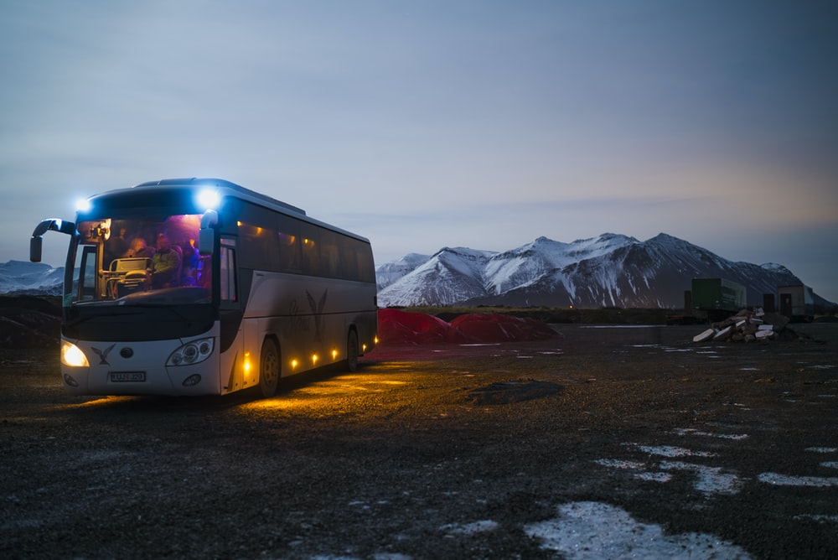
Thank You
Team
Easy Journey

